Slide 1
Incident Response Training
CC NC-BY-SA
Otter Tech LLC
sharp@otter.technology

Slide 2
Introductions:
Name
Pronoun you use
and what events you organize
or what community you lead

Slide 3
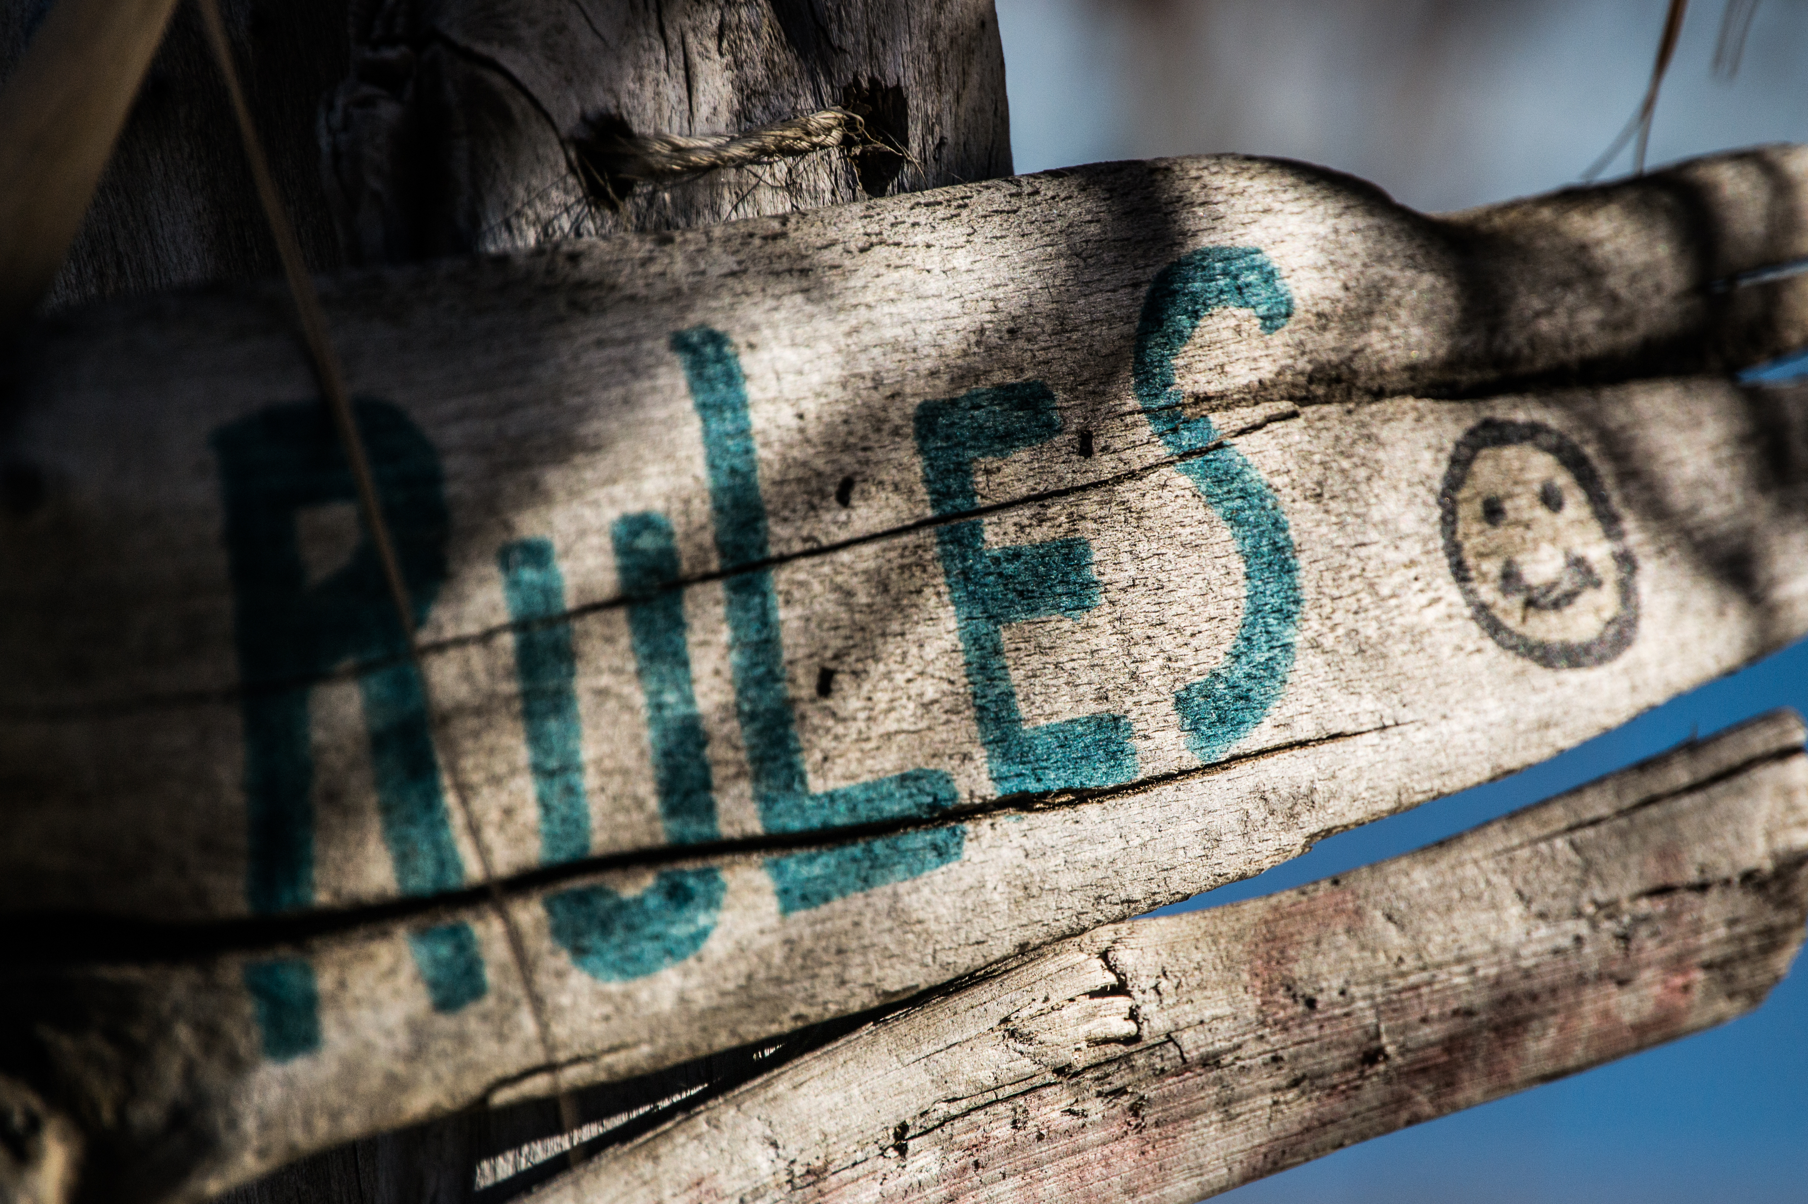
Ground Rules
This is a safe(r) space
If you are asked to stop, you will stop
You may leave at any time
Be open to new knowledge
Acknowledge different lived experiences
CC BY Steve Johnson

Slide 4
Agenda
Who is an incident responder?
Taking an incident report
Practice 1
Responding to a report
Practice 2
Advanced topics, questions, and/or more practice

Slide 5
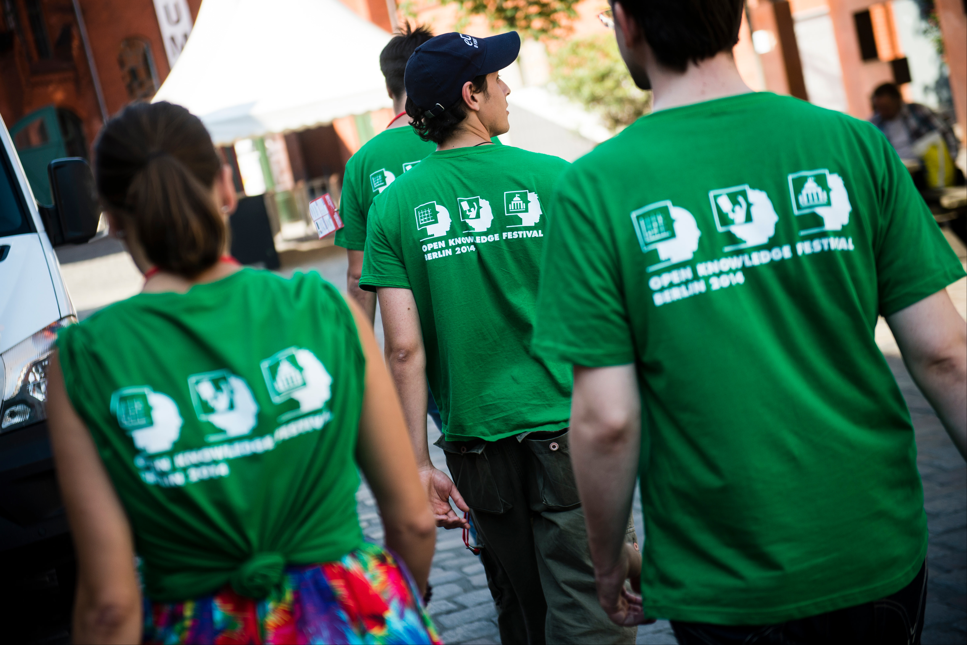
Who is an incident responder?
Takes incident reports
Assesses the situation
Finds additional help
Resolves the incident
Responds to those impacted
Communicates incident to other staff
CC BY Open Knowledge

Slide 6
Receiving an Incident Report
Goals:
Be a neutral third-party to gather data
Be an active listener and don't judge
Ensure the reporter's safety
Procedure:
Go to a quiet, private place (or private message/email)
Clarify any confusion you have
Thank reporter, acknowledge it was right to report
Ask how to contact the reporter for follow up
Get names and contact info
Seek additional resources for the reporter
Notes:
Evidence: pictures, screenshots, IRC chat logs, tweets
Be explicit about who will receive the report - is this ok?

Slide 7
Example:
Receiving Reports

Slide 8
Practice
Receiving Reports

Slide 9
Incident Report Practice
Group discussion:
describe the incident
any additional witnesses?
any additional details?

Slide 10
Bias in Receiving Incident Reports
Responders gathered different information
Reporters have different lived experiences
Don't use "judgment" words
Watch yourself for defensiveness
Be cautious about empathy for reported person

Slide 11

Microaggressions & Trust
Unconscious bias made invisible by privilege
Death by 1,000 paper cuts
Emotional labor
People often over-react
Different lived experiences
CC BY Andrew McGill

Slide 12

Intent is Not Magic
Ignorance is no excuse
Actions have impact
No tone policing victims
Reverse racism isn't real
No “I'm sorry if I hurt you”
CC BY Fabricio Zuardi
(modified)

Slide 13
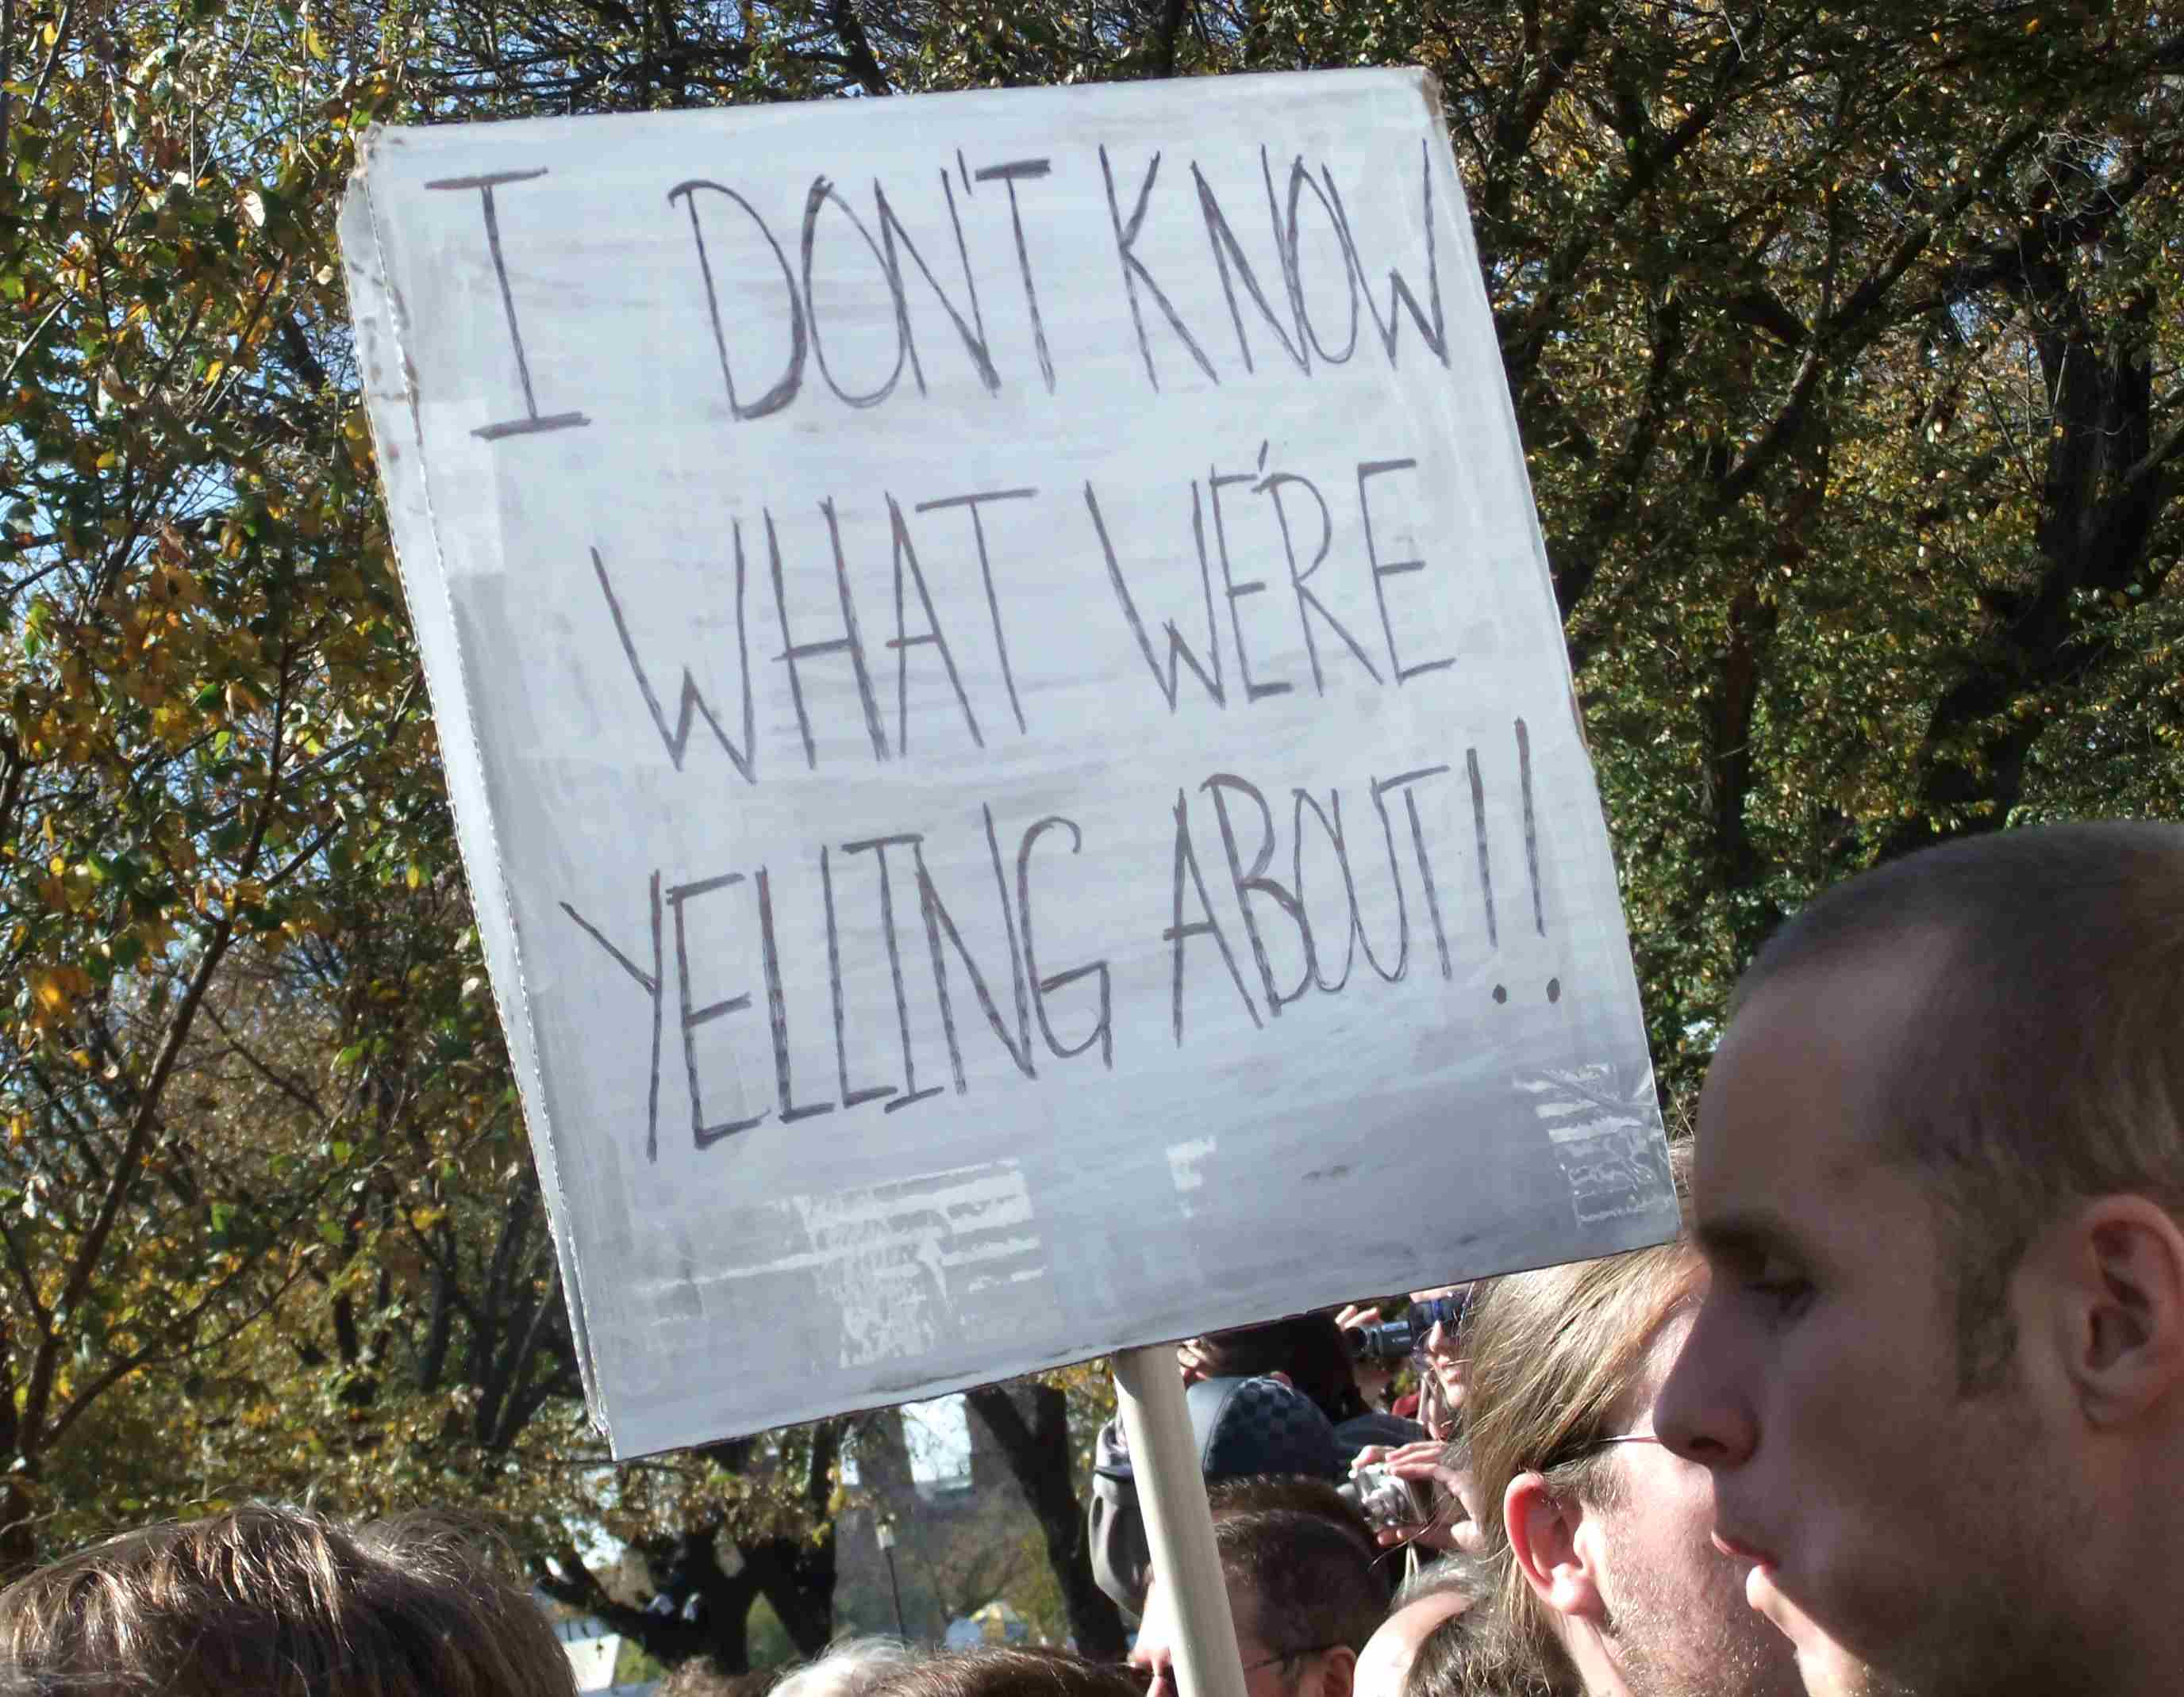
Personal Conflicts
Not all conflicts will be a Code of Conduct violation
Is this part of a larger pattern of behavior?
Other examples of emotional or verbal abuse?
Possible resolutions:
Ask not to contact each other
Assign different areas of work
Assign different evening events
Attend on different years
CC BY Martha Soukup

Slide 14
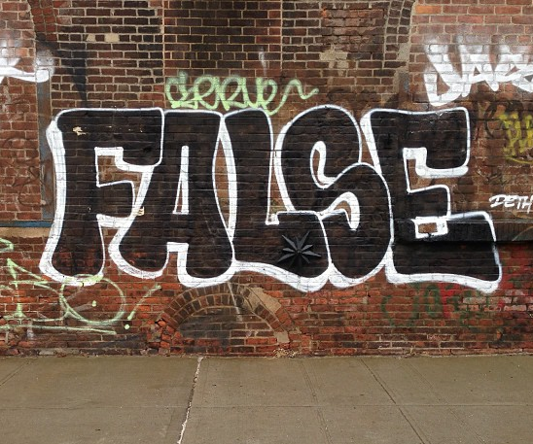
False Reporting: Power Dynamics
What does a reporter have to lose?
Reputation
Career
Financial support
Safety
Mental health
What does the reported person have to lose?
CC BY Adam Lehman

Slide 15
Review All Reports Carefully
Microaggressions are under reported
Does a report “punch up” or “punch down”?
Assume good intent
Don't victim blame
Don't assume a friend is innocent or had good intent
CC BY Adam Lehman

Slide 16
(Break?)
Following up on
Incident Reports

Slide 17
Evaluating Risk
 | Low Risk | High Risk
Low Impact | Microaggression in conversation Microaggression in private message | Attendee has past sexual assault allegations Contributor repeatedly pushes boundaries
High Impact | Racist or sexist joke during presentation Inappropriate joke on a public channel | Ongoing harassment or stalking Online harassment campaign or doxxing

Slide 18
Deciding Response
 | Low Risk | High Risk
Low Impact | “That's not appropriate.” “You will be removed if you continue” | Create safety plan Monitor and document patterns of behavior, possibly warn or ban
High Impact | Reprimand or removal Public response from staff or organization | Coordinated planning Additional resources Reach out to others

Slide 19
Following up with the reported person
Find a private place (or send a private email)
Repeat the facts with specific examples
Let them respond
Focus on the impact on the reporter(s)
Reiterate the consequences of their behavior
Don't reassure
Don't let them contact reporter
Give them a concrete plan of action for modifying their behavior
Notes:
“Hi, can I speak with you privately?”
“That's not appropriate.”
“They asked you to stop.”
“This is a private venue.”

Slide 20
Example:
Following up with
the Reported Person

Slide 21
Practice:
Following up with
the Reported Person

Slide 22
Following up with reporters
Follow up is optional
Try to talk to everyone impacted
May need a public statement
Whisper networks exist
Don't justify your actions
Document the incident
May need to notify volunteers

Slide 23
Advanced Topics

Slide 24
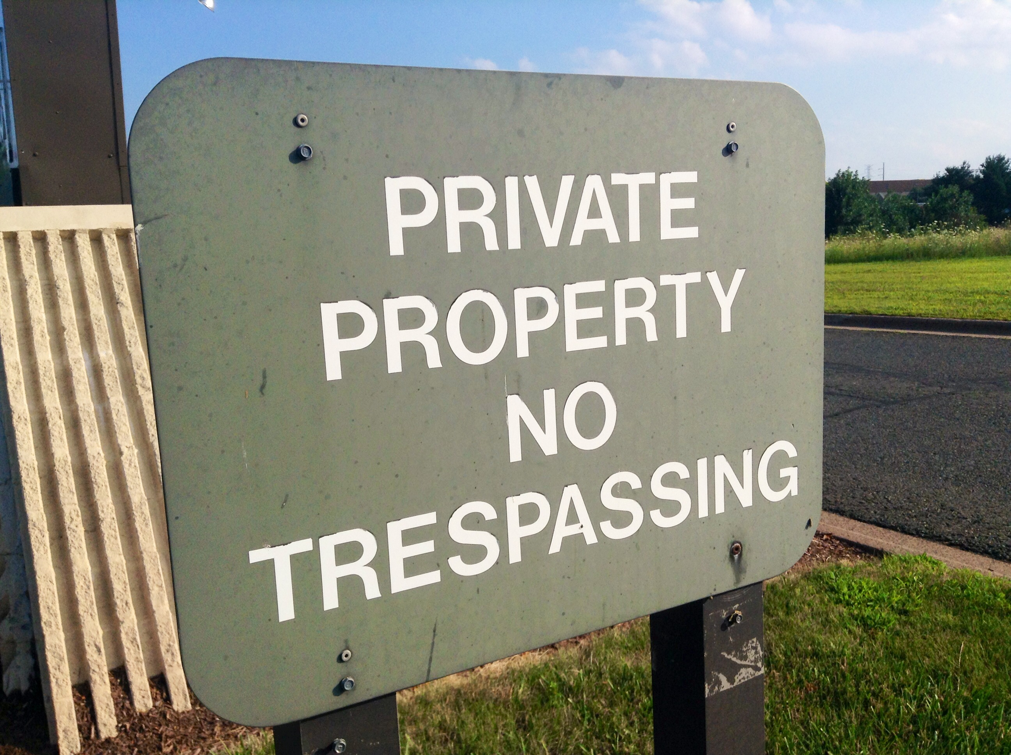
Dealing with Unwelcome Attendees
“You aren’t permitted to attend the conference”
Don’t provide details
Ask them to leave
“This is a private venue”
Get onsite help
Report for trespassing
Know your local trespassing laws
CC BY Mike Mozart

Slide 25
Dealing with Weapons Policy Violations
“Weapons are not allowed at our conference”
Ask them to leave
Come back without the weapon
Do not argue, be firm
Ask staff, response team, security to help
If there is a safety risk, call 911

Slide 26
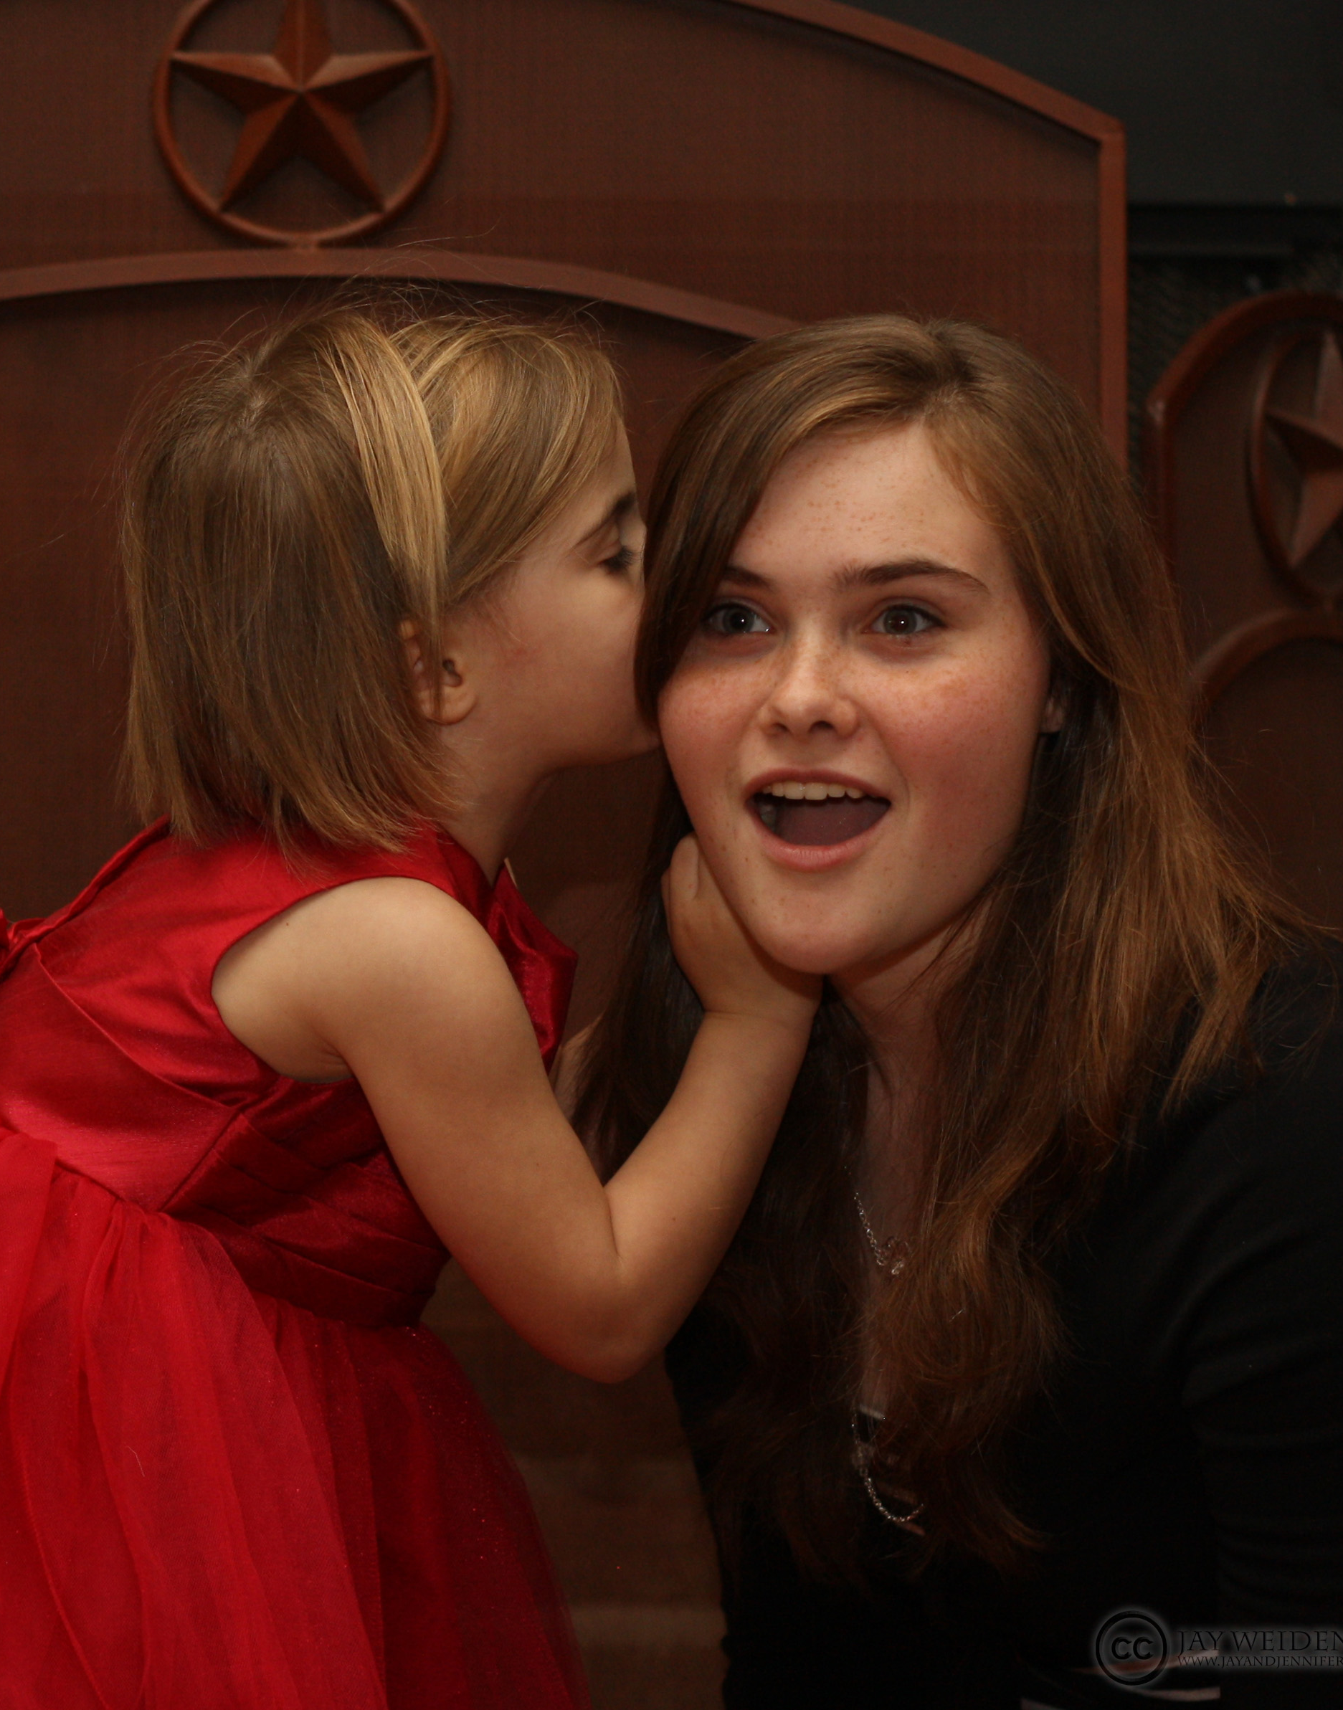
Conflicts of Interest
Is anyone a friend or coworker?
conference staff or volunteers
incident response team
papers committee
sponsors
Review leadership positions for potential leaks:
other incident responders
volunteers & staff
papers committee
board members
CC BY Jay Weldenbach

Slide 27
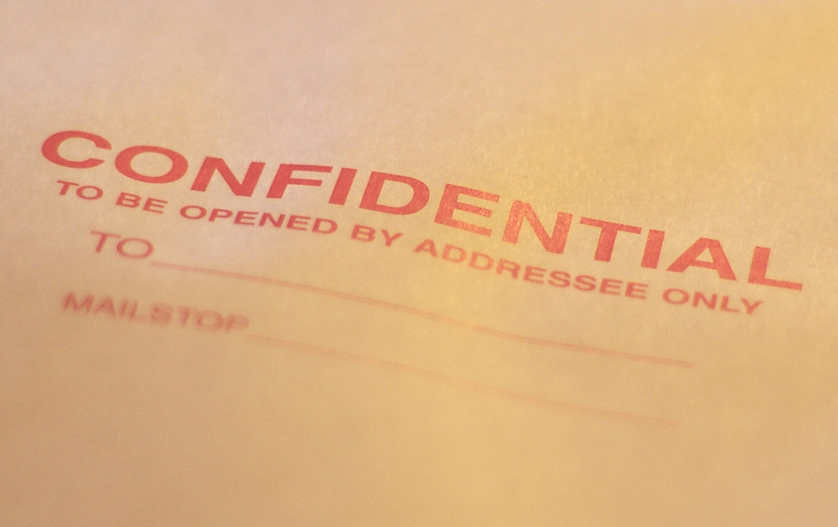
Confidentiality Issues
Reporter fears retaliation
NDAs & severance
Police Investigation
Limit incident docs access
Ask around (discretely)
Often multiple incidents
Other grounds to dismiss
CC BY Casey Marshall

Slide 28
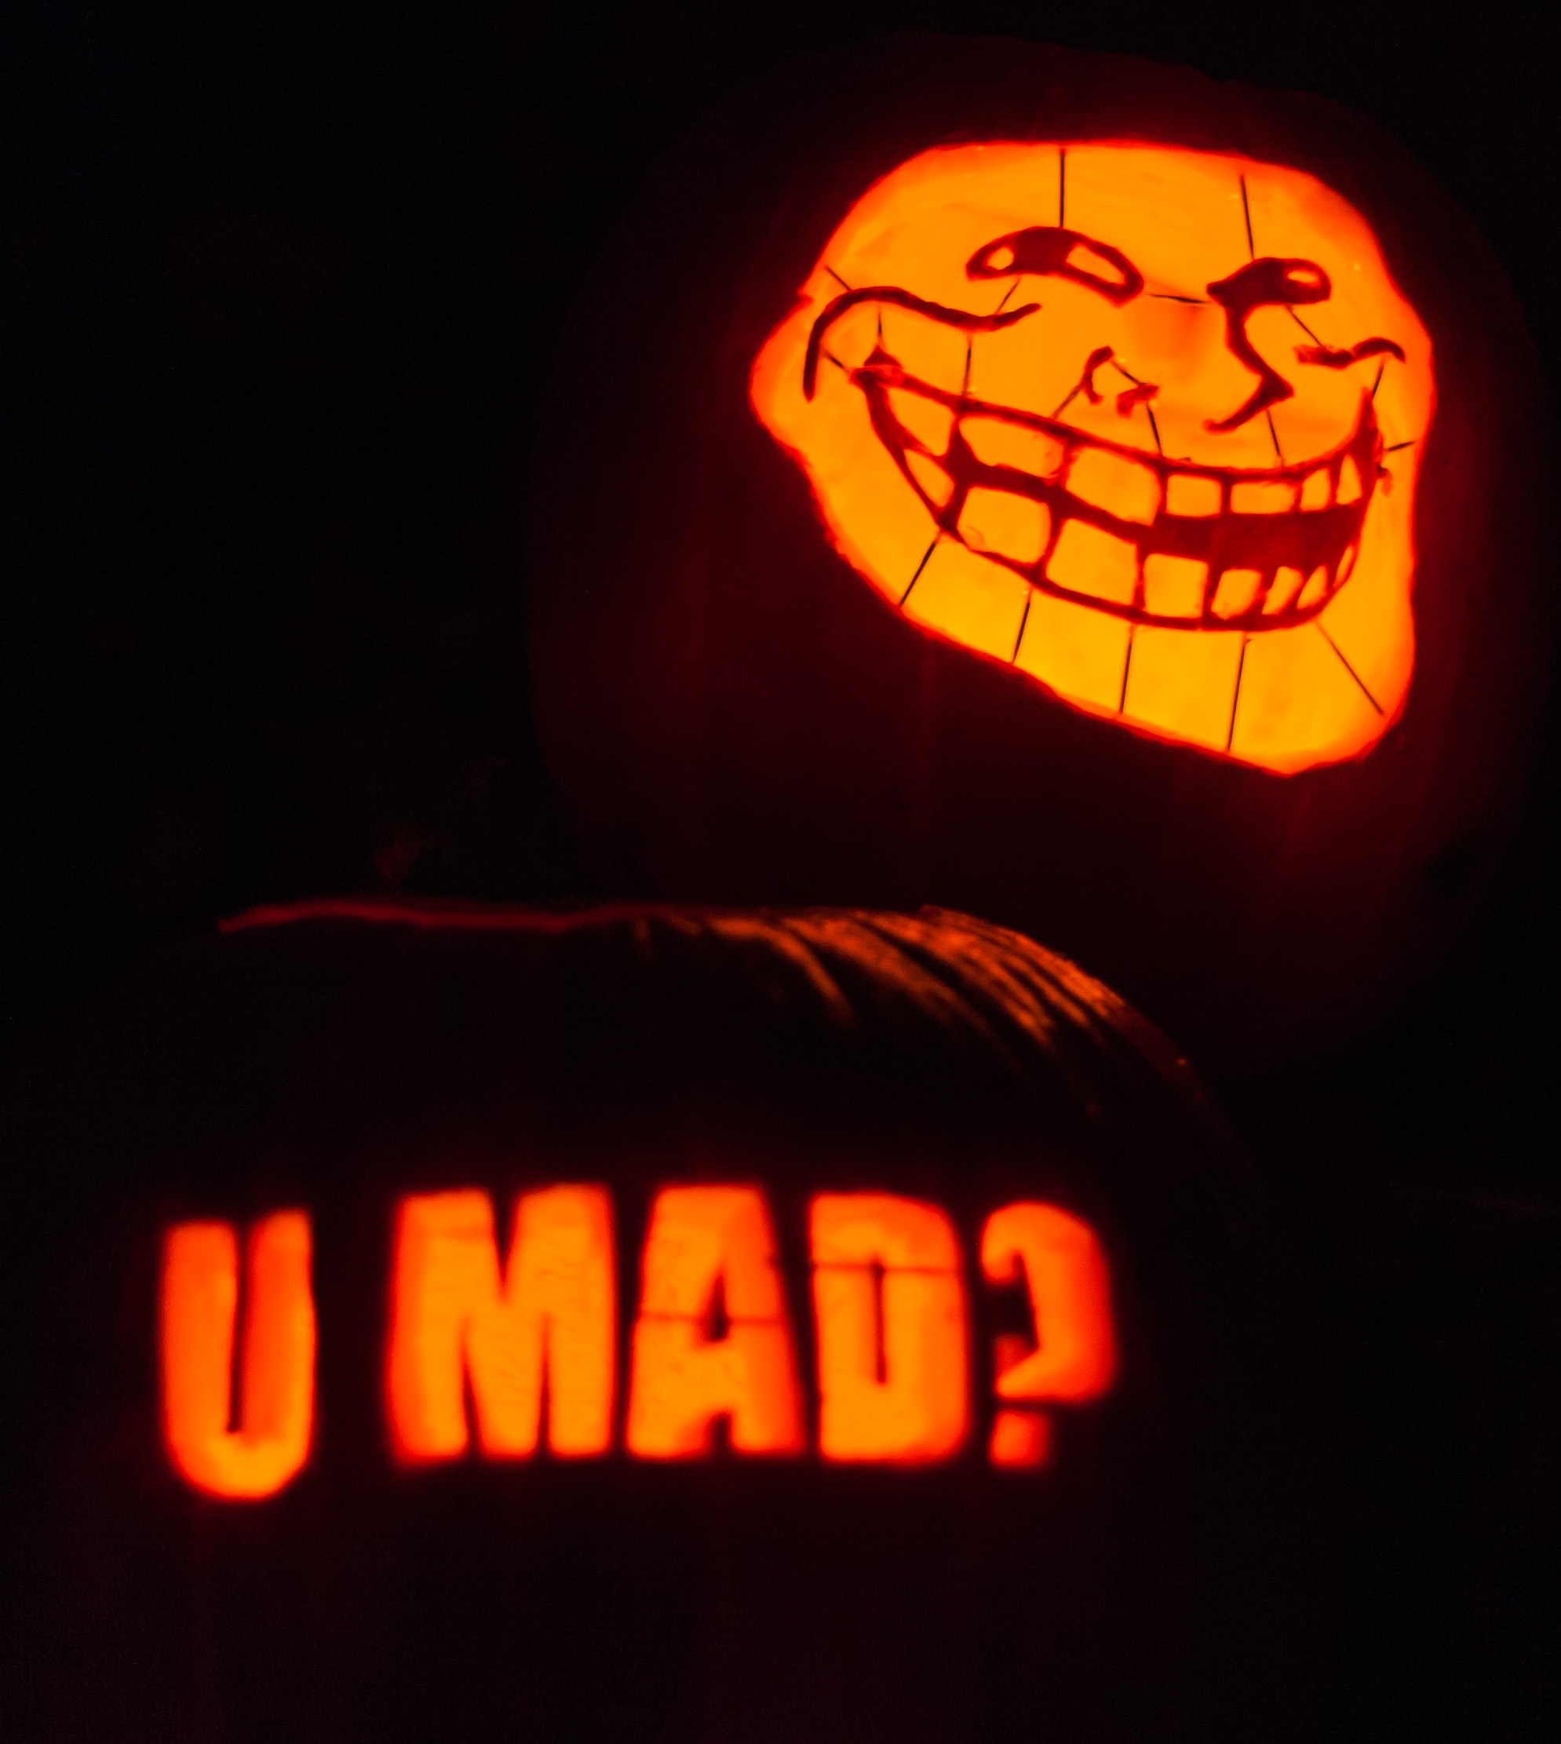
Known Harassers
Not just internet trolls
Stalkers do show up
Power plays & disruption
Have a mitigation plan
Strict confidentiality plan
Ensure attendee safety
CC BY Paul VanDerWerf

